Slide 1

Chicago Crime
Team 2: Luqi Chen, Lindsay Neufer, Anish Pahwa, Arun Ramakrishnan, Juliet Zhang

Slide 2
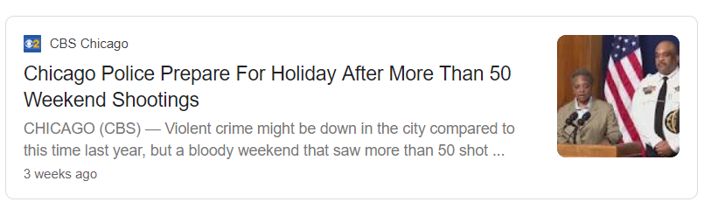
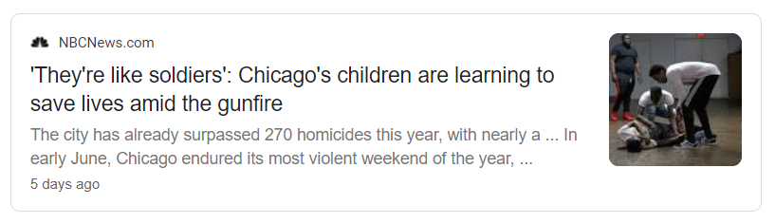
Intro
Reputation for crime in the US
Relevant for both tourists and residents alike
Want to help others make informed decisions when in town
Notes:
Ranked #21 most dangerous city according to an article published by USA Today Travel in February of this year.

Slide 3
Agenda
/
Exploratory Data Analysis
Crime frequencies across type
Arrested and not arrested
Seasonality and trends
Guide for Tourists
Location, block, community, side
Time of day, day of the week
Locations for street threats
Improve Crime Rates
Major crime identification
Highly correlated crimes
Optimal locations for deploying police force

Slide 4

Exploratory Data Analysis

Slide 5
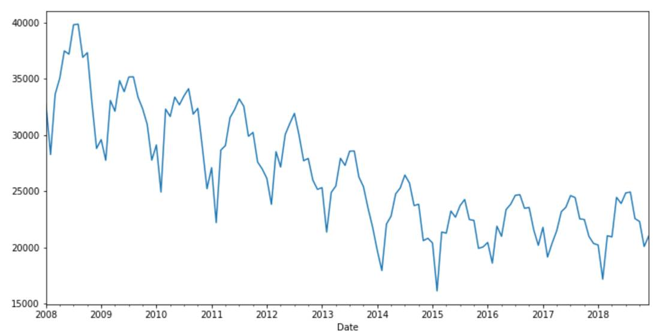
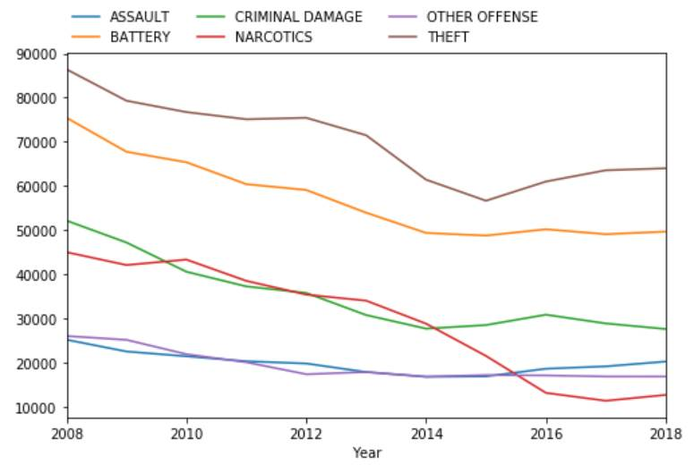
General Factors about Crime in Chicago
In 2018, 261,636 cases have full records
In August of 2018, there were 24770 cases
Theft is the most frequent crimes in all primary type of crimes, followed by battery
In 2013, narcotics was the third highest crime and has seen a continuous decline since

Slide 6
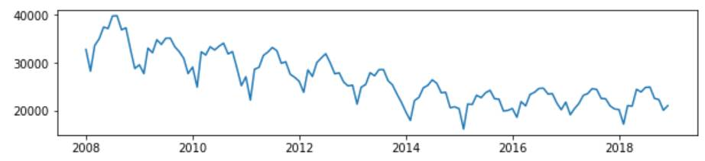
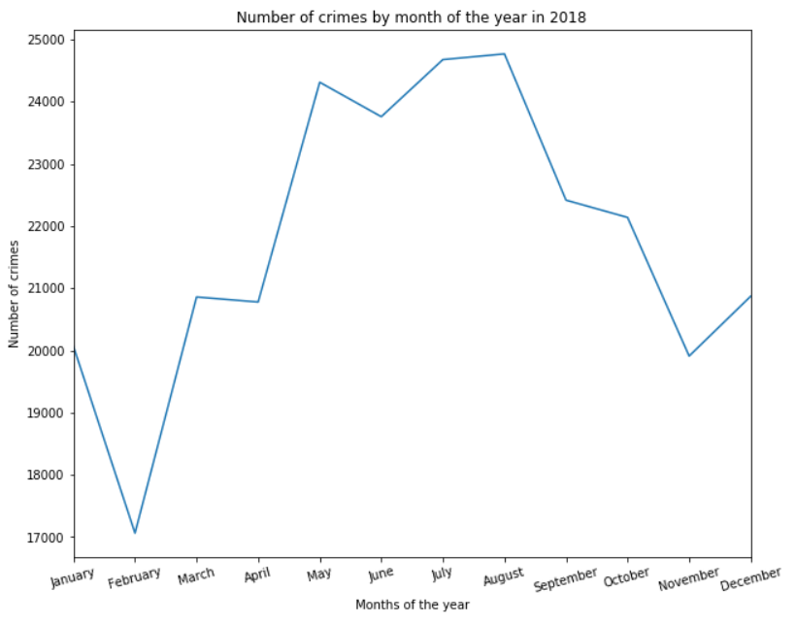
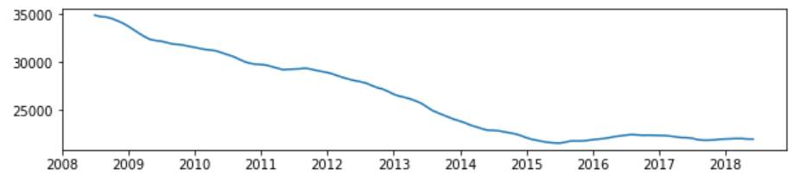
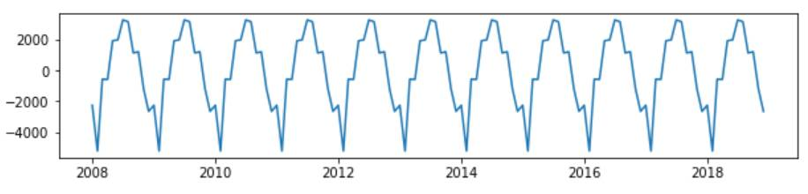
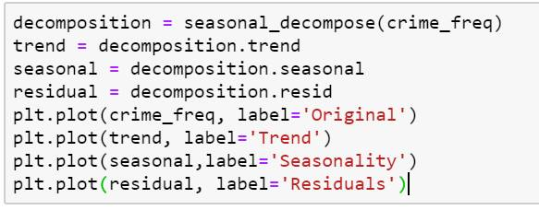
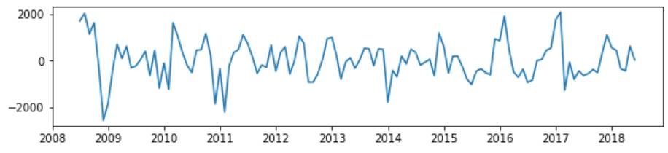
Crime Frequency over Time
Original
Trend
Seasonal
Residuals

Slide 7
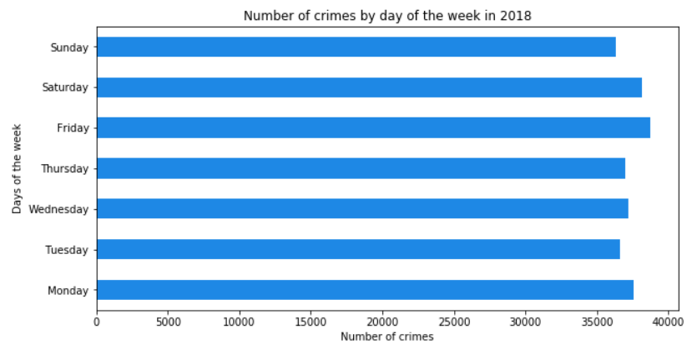
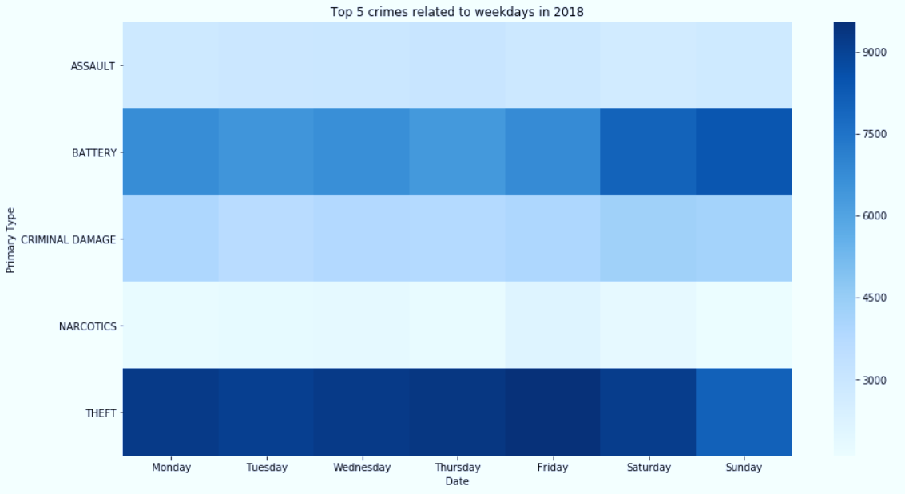
Type and Frequency of Crimes by Weekday

Slide 8
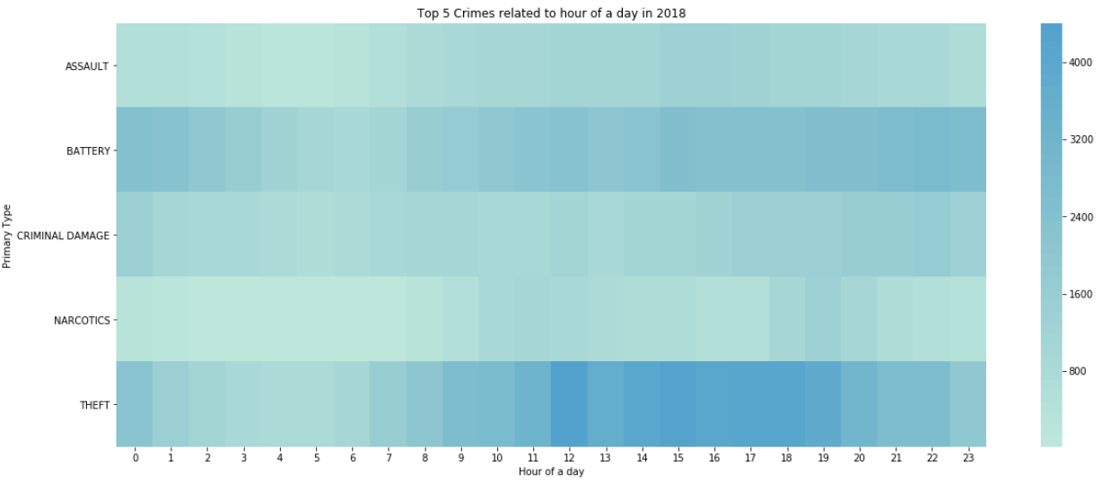
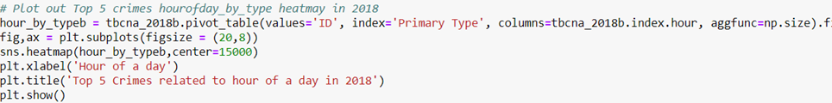
Crime by Hour of Day

Slide 9
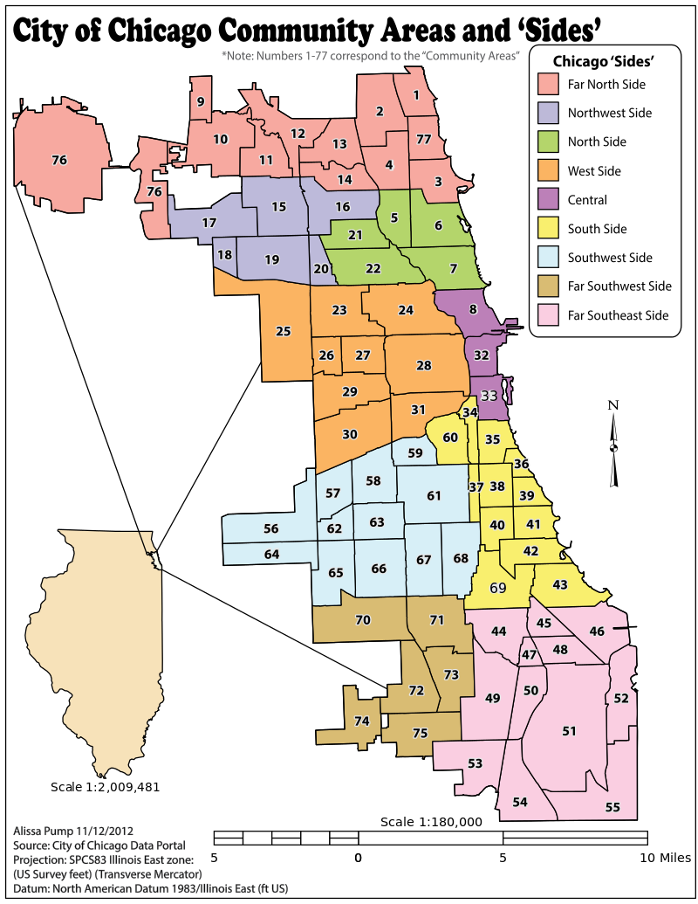
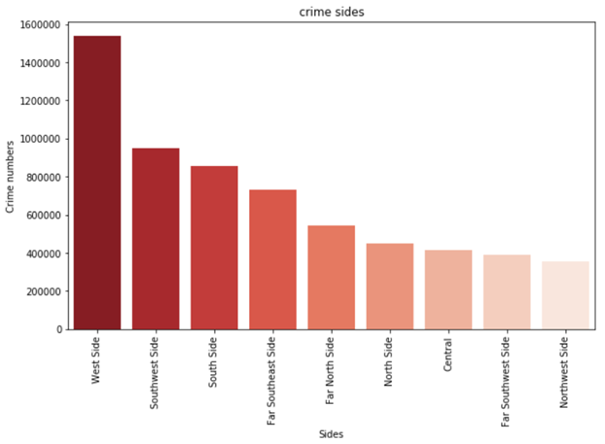
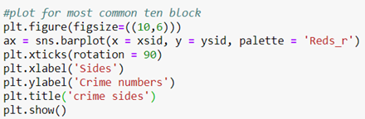
Frequency of Crimes across Sides

Slide 10
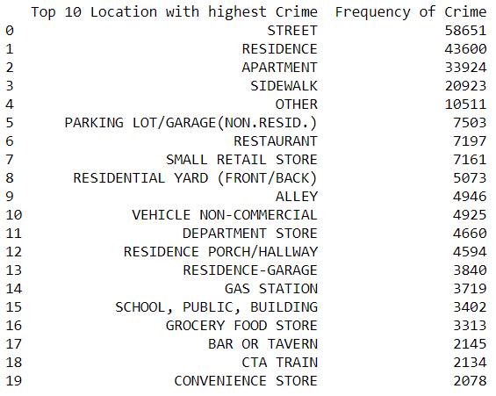
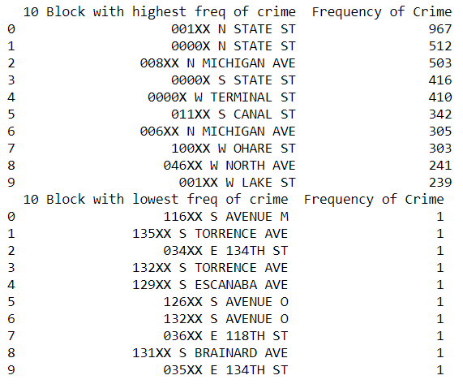
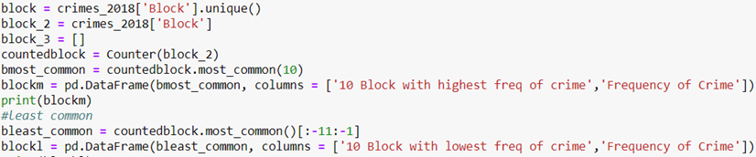
Crime Analysis in 2018: Location, Block

Slide 11
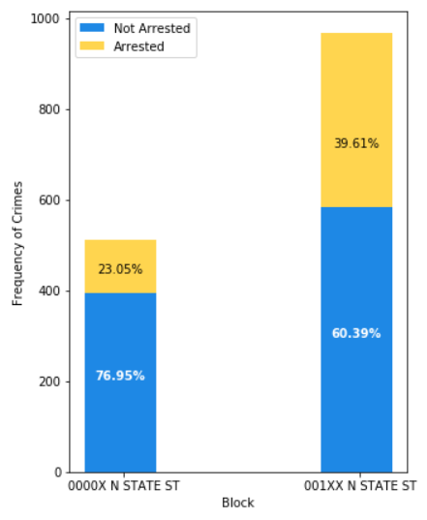
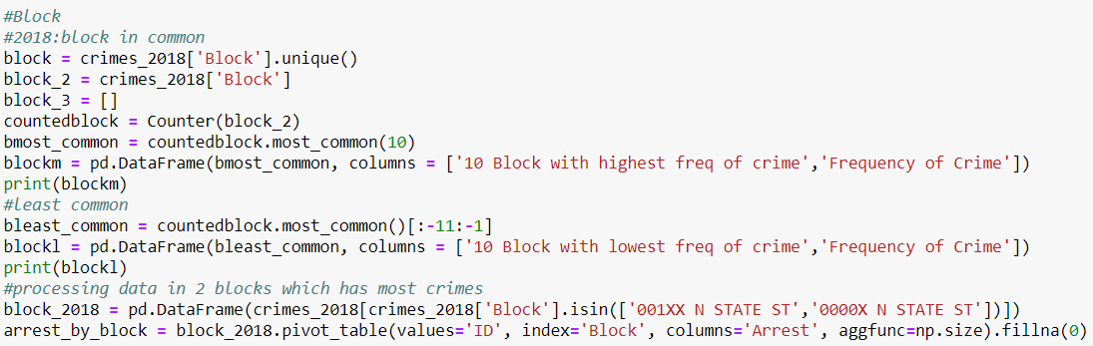
Arrests on Most Crime Ridden Blocks in 2018

Slide 12
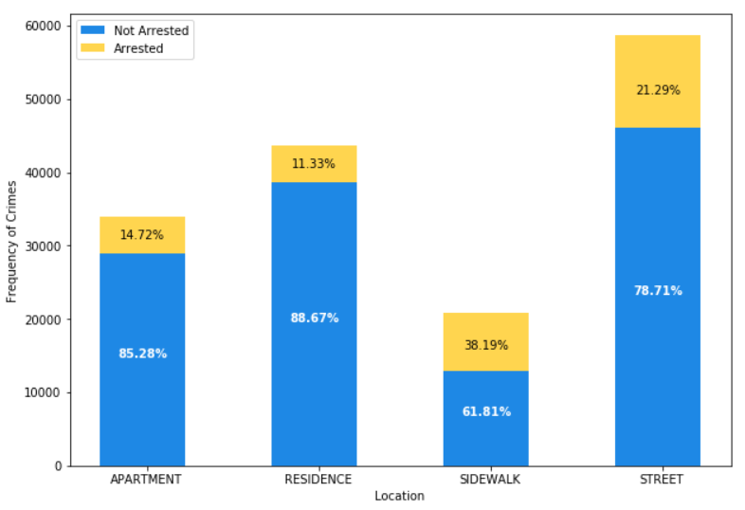
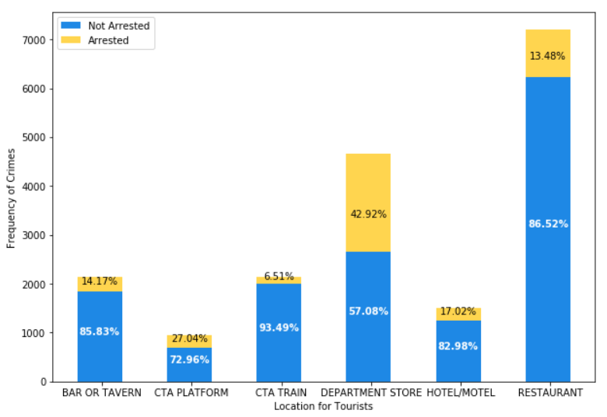
Most Crime Ridden Locations in 2018

Slide 13
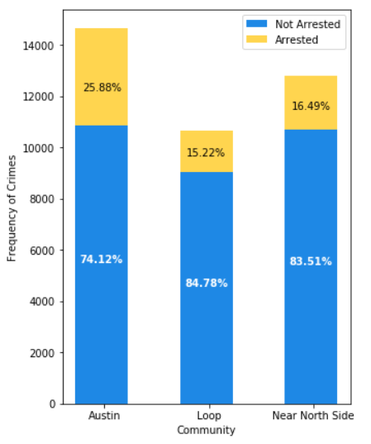
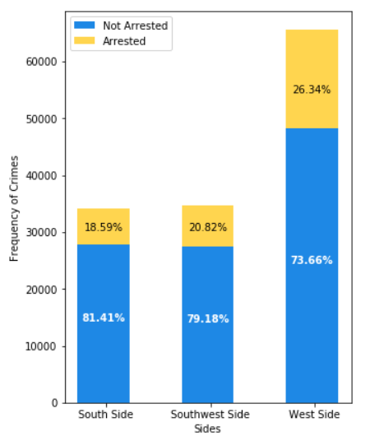
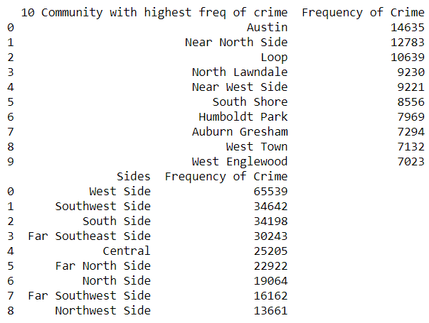
3 Communities and Sides with Most Crime in 2018

Slide 14

Tourism and New Resident Analysis

Slide 15
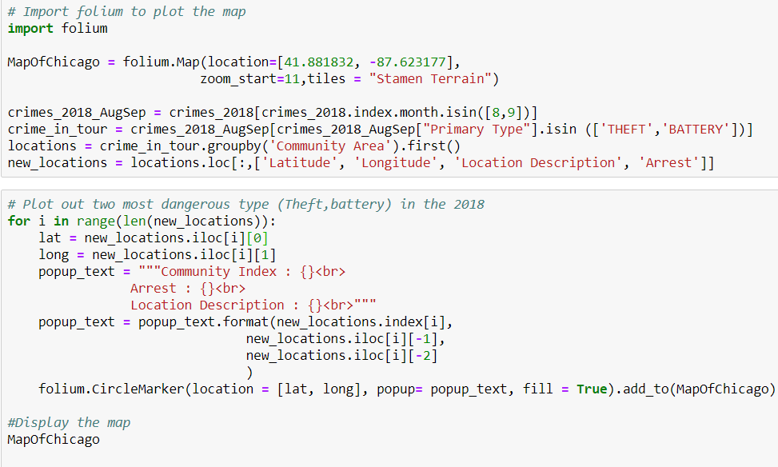

Slide 16
Strategy to Improve Crime Rate

Slide 17
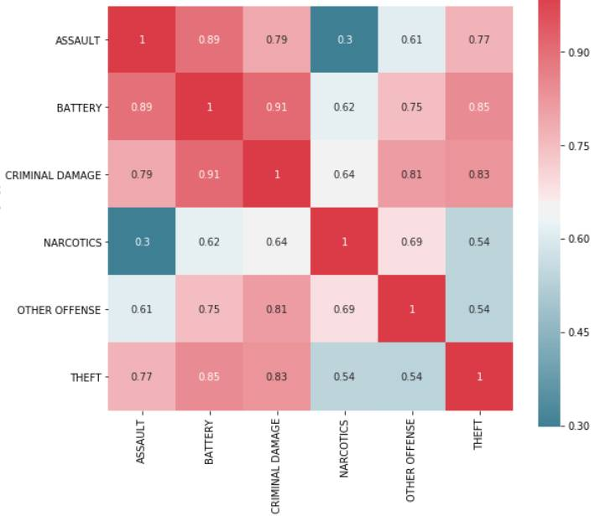
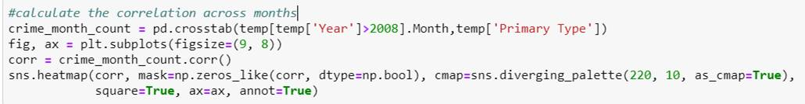
Correlated Crimes

Slide 18
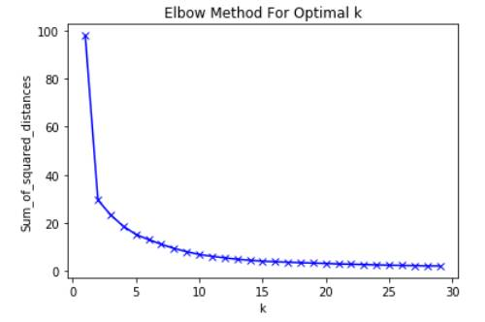
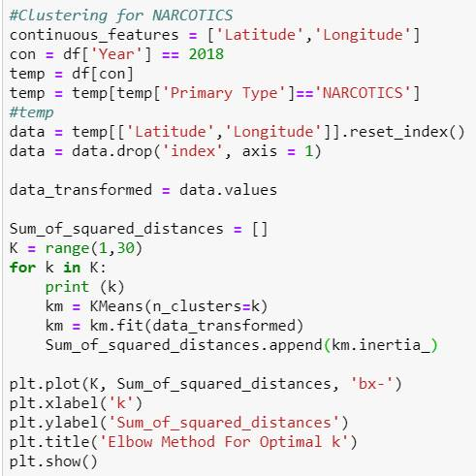
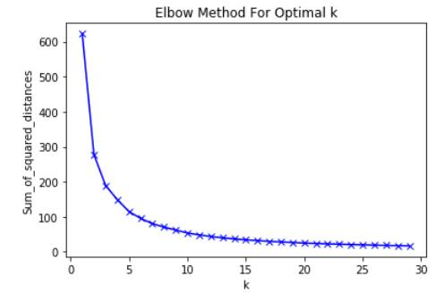
K Means to Identify Optimal Police Locations
K=5 Narcotics
K=7
Theft

Slide 19
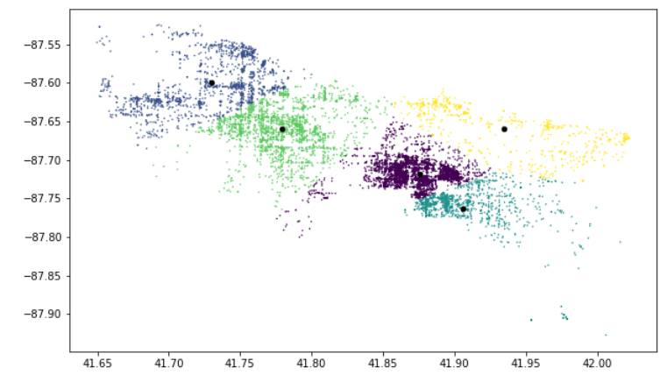
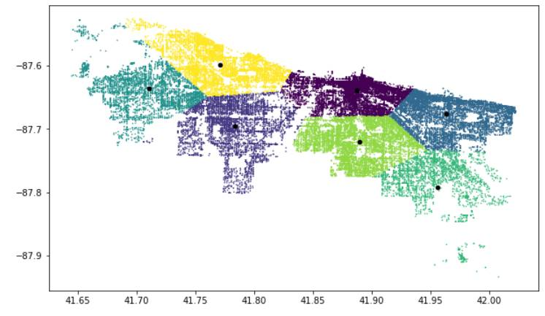
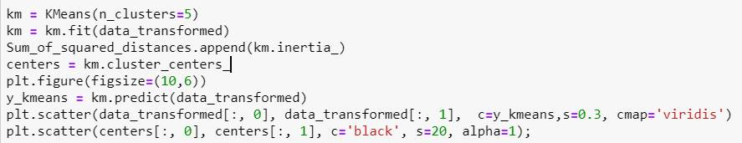
K Means to Identify Optimal Police Locations

Slide 20
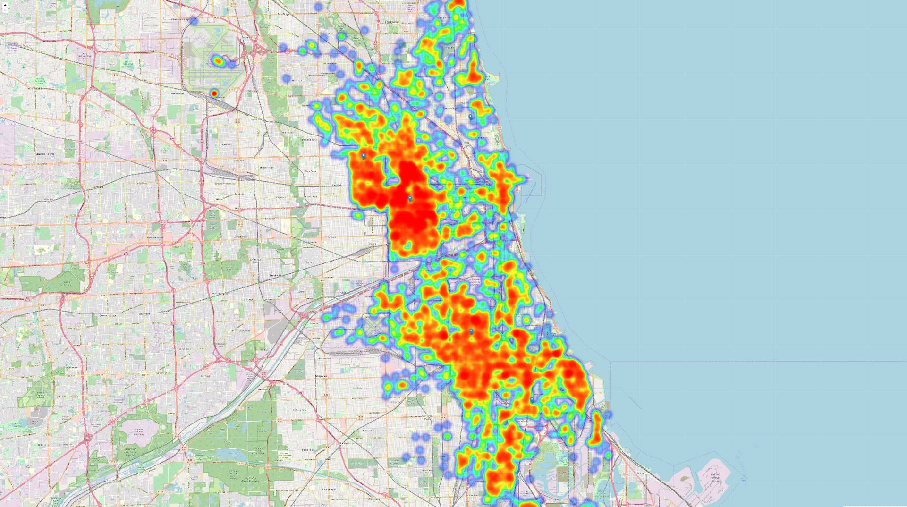
Narcotics Heat Map
2018

Slide 21
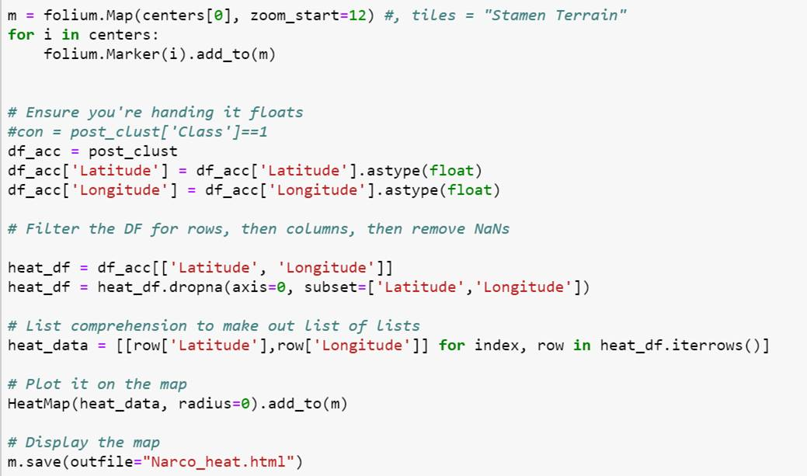

Slide 22
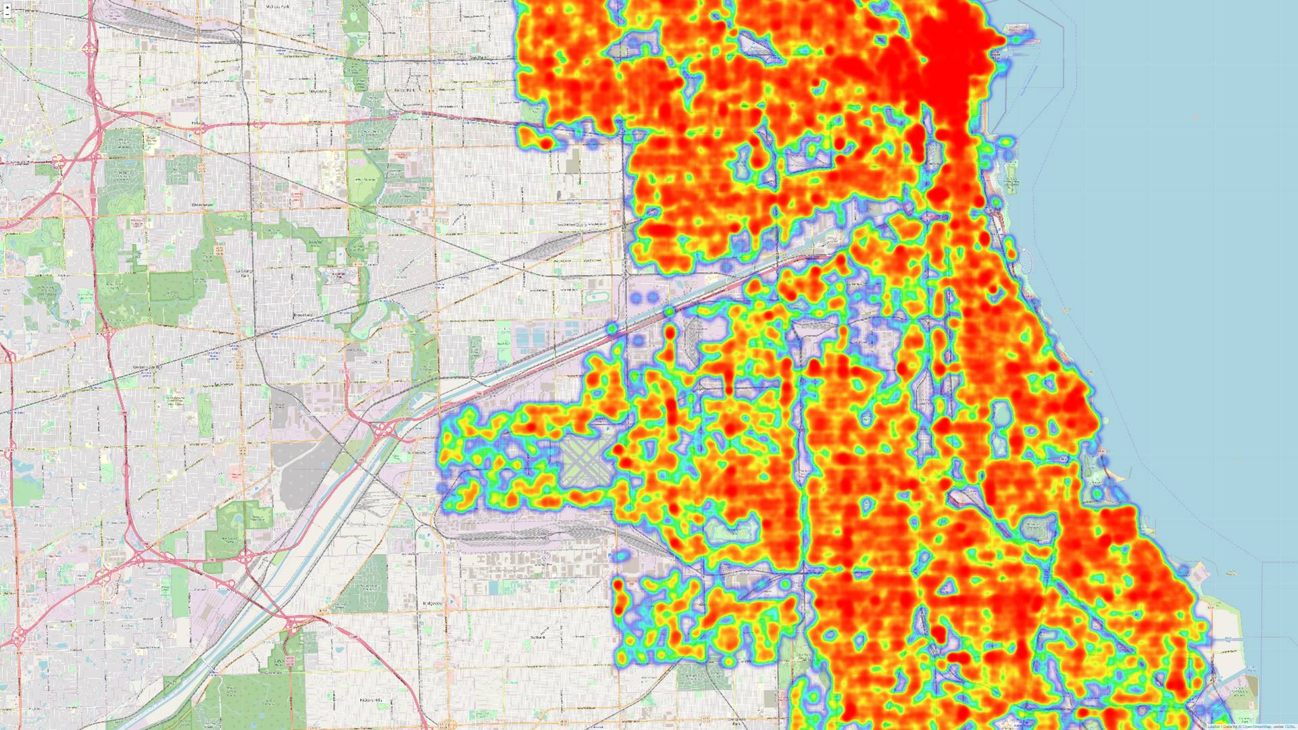
Theft Heat Map
2018

Slide 23
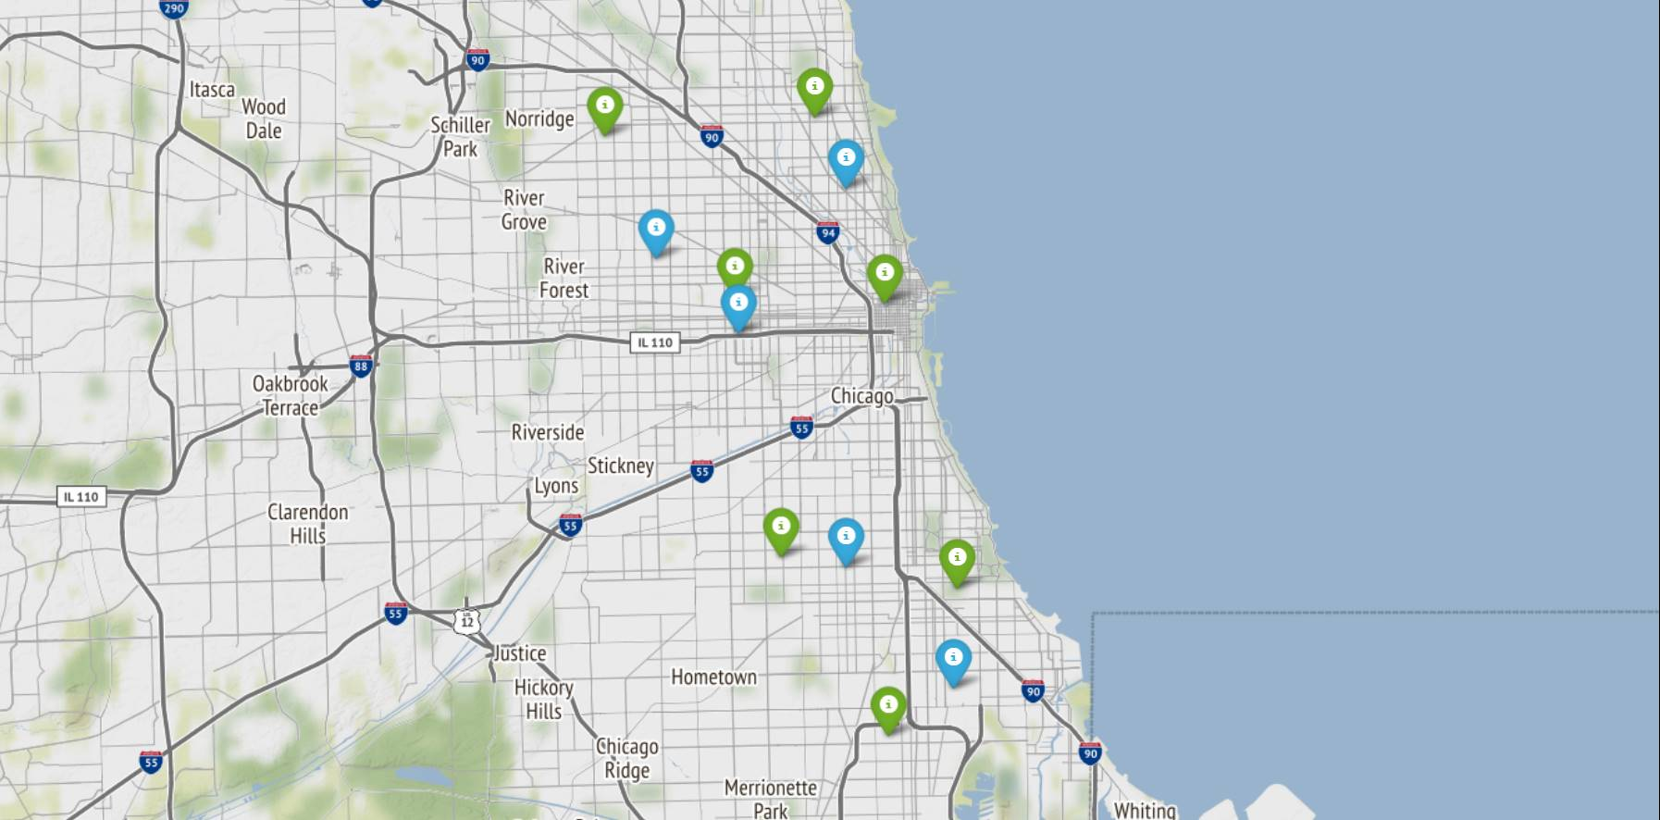
Centroids for Narcotics and Theft
Narcotics
Theft

Slide 24
Q&A

